Slide 1
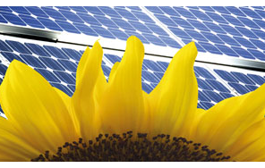

Controls:
From a DC Power Perspective
DC – The Power to Change Buildings
Kevin Schader
Executive Director – EMerge Alliance
Smart Power Standards
Notes:
Introduce self and subject.

Slide 2


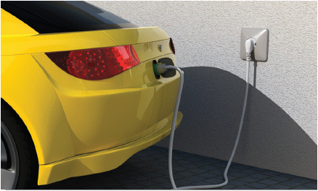
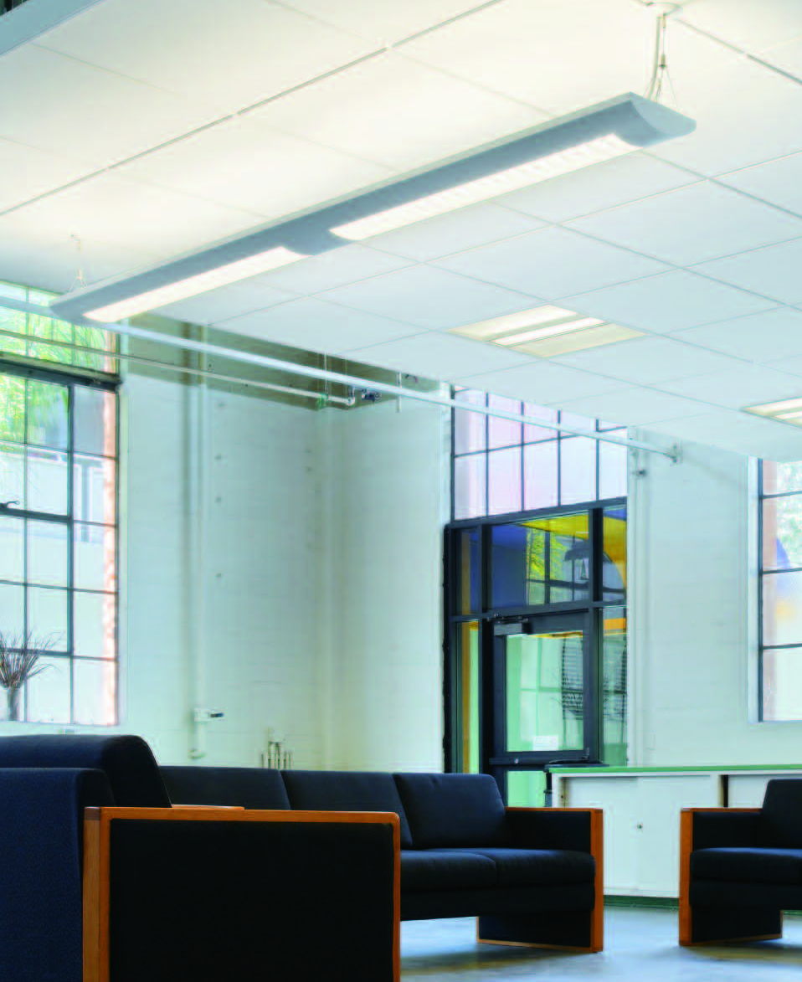
Dramatic Increase in DC Power Use
The use of DC power is often hidden
DC
Power
Up to 80%
of Electric Load
Comes from DC-Electronically Powered Devices
Most equipment requires AC power conversion to DC
Distributed generation natively produces DC power.
Electricity is stored and/or delivered as DC
DC Distribution improves energy efficiency & reliability
DC reduces charging times for hybrid/electric vehicles
Notes:
Most equipment requires AC power conversion to DC:
All microprocessors require direct current and many devices operate internally on dc power since it can be precisely regulated for sensitive components.
Building electrical systems are fed with ac that is converted to dc at every fluorescent ballast, computer system power supply, and other electronic device.
As one specialty electronics manufacturer put it, "dc is the blood of electronics.“
Distributed generation natively produces DC power:
Many distributed generation sources such as photovoltaic cells and fuel cells – and advanced energy storage systems (batteries, flywheels, and ultra capacitors) – produce energy in the form of dc power.
Other devices can also be suited to dc output, such as microturbines and wind turbines.
Even hybrid vehicles such as the Toyota Prius could serve as dc generators in emergencies with the right equipment to connect them to the electrical system.
Electricity is stored and/or delivered as DC:
Storage devices such as batteries, flywheels and capacitors store and deliver dc power.
This again helps avoid unnecessary conversions between ac and dc.
DC Distribution improves energy efficiency & reliability:
Improved power electronics allow dc power to be converted easily and efficiently to different voltage levels.
Component improvements enable greater efficiency than in the past, and improve the economics of hybrid ac-dc systems.
Although improved electronics also enhance ac-only systems, such enabling technology makes the dc power delivery option feasible as well.
DC power could help power hybrid automobiles, transit buses, and commercial fleets:
Plug-in hybrid vehicles can go greater distances on electricity than today's hybrids since they have larger batteries.
These batteries store dc power, so charging them with electricity from solar photovoltaic arrays and other distributed sources could reduce reliance on gasoline…
…enhancing security and emergency preparedness.

Slide 3
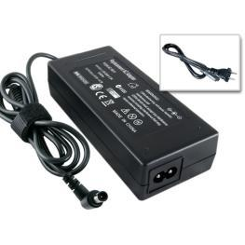
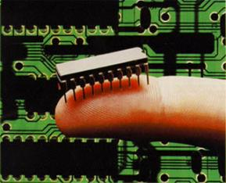
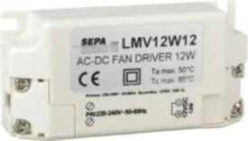
DC Power Distribution Drivers
Solid-state IC technology has changed the game
DC
Power
5-20%
Energy is wasted in unnecessary ac-dc power conversions
Improved power electronics allows simple DC -DC conversions to replace more complex AC-DC and DC-AC inversions
The evolution of DC power architectures and power electronic devices simplifies dc power delivery systems.
DC power distribution simplifies the use of micro-grids for distributed energy generation & storage integration, operation, & improved performance.
Notes:
Improved Power Electronics:
Increasingly, equipment operates on dc, requiring conversion from ac sources.
All microprocessors require direct current and many devices operate internally on dc power since it can be precisely regulated for sensitive components.
Building electrical systems are fed with ac that is converted to dc at every fluorescent ballast, LED driver, computer power supply, and other electronic device.
As one specialty electronics manufacturer put it, "dc is the life-blood of electronics.“
The evolution of DC architectures:
New DC Power architectures can avoid the 5-20% wasted energy incurred with unnecessary ac-dc power conversions
DC Power Distribution:
DC power delivery can enhance micro-grid system integration, operation, and performance.
A number of attributes make dc power delivery appealing for use in micro-grids. With dc distribution, solid-state switching can quickly interrupt faults, making for better reliability and power quality.
If tied into the ac transmission system, a dc power micro-grid makes it easier to avoid back-feeding surplus generation and fault contributions into the bulk utility system (by the use of a rectifier that only allows one-way power flow).
In addition, in a low-voltage dc system, such as would be suitable for a home or group of homes, a line or wire of a given size and voltage rating can transmit more dc power than ac power.

Slide 4
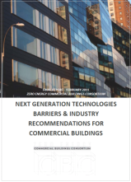


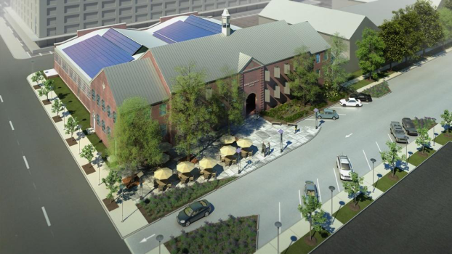
DC Accelerates Net Zero Attainment
The right approach can save time and money
  Integrated design and operations planning
  Site renewable strategies get optimized using dc
  Energy Storage in dc allow Grid independence
  System Intelligence control, monitor, verify
Net Zero Energy
Native DC Load Efficiency
DC
AC
On-site Electricity Demand
Native DC Generation Efficiency
Distributed Renewable Energy
“DC power would fundamentally change the way power is distributed in commercial buildings…”
2013: Begin DC Microgrid Demonstrations
2030: All new commercial buildings
2040: 50% of commercial building stock
2050: All commercial buildings
Energy Efficient Buildings Hub
EMerge Alliance Corp - ©2009-2010
Notes:
DC Accelerates Net Zero Attainment:
The new Energy Economy is also bringing in a new set of goals that are supported widely by both political and commercial interests.
Perhaps the most visible of these goals is the desire for Net Zero Energy Buildings.
Consideration of this design goal requires new approaches to design, energy infrastructure, and power control and management.
Most organizations espousing such goals have relatively ambitious timelines.
The Emerge Alliance believes that an aggressive move toward the use of DC microgrid platforms can reduce the cost and time needed to reach these goals.
First by improving the yield of natively generated DC or non-synchronized AC
And second, by reducing the losses associated with distributing this energy to the load devices needing the power.
The combined effect of both can move the equilibrium point of achieving Net Zero Energy closer in timing and affordability.

Slide 5

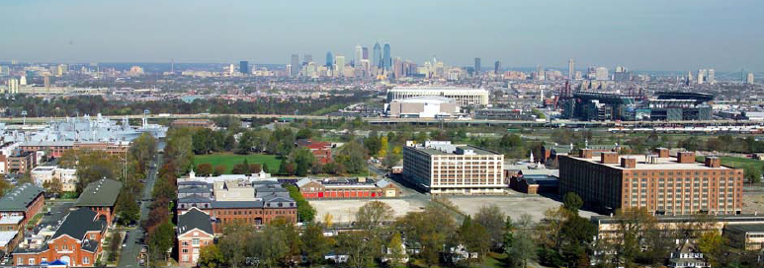
Challenge of Existing Buildings
Existing buildings need to be transformed
Net
Zero
Retrofits
Renovation
Re-Use
85% of buildings
that will exist in 2030 are here today!
Notes:
Challenge of Existing Buildings:
Many individuals and groups are now focusing on the Challenge of existing buildings…
…in terms of Sustainability with LEED for Existing Buildings…
…and Deep Retrofits for energy in existing buildings
Just one example of a group creating strategies for existing buildings is in Philadelphia…
…where the U.S. Dept of Energy has funded an “Innovation Hub” for existing buildings, called the Energy Efficiency for Buildings Hub (or EEB HUB)

Slide 6
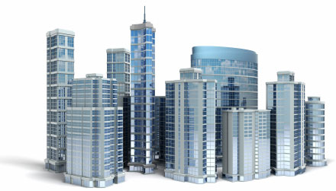
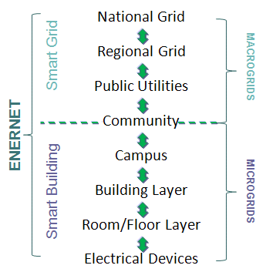
Microgrid Networks Are Emerging
Microgrids are like scalable networks
DC Power Standards
Benefits:
Autonomy
Stability/Reliability
Compatibility
Flexibility
Scalability
Efficiency
Economics
Peer-to-peer connectivity
Notes:
Microgrid Networks Are Emerging:
The power equation is one of the key facets linking Building Design to national electrical “Smart Grid” efforts
The way we generate and use power IN our buildings --- A “Microgrid” approach…
…iIs getting increasingly linked to how we make and distribute power at the national electrical grid level – or the “Microgrid
The increasing concern with the strain and vulnerability of our electrical Macrogrid system…
…witness the recent “blackout” in Southern California due to one utility worker mistake out in Yuma, Arizona…
…or the Blackout in the Northeast in 2004.
This is putting more emphasis on creating more independent, Building-level Microgrids to yield expanded benefits…
BENEFITS:
The benefits of microgrids include…
Autonomy – can be islanded, or disconnected, from other grids
Stability/Reliability – Isolation (buffering) can protect them from damaging grid disturbances and provide better power surety via interruption protection
Compatibility– can be easily connected to ac distribution to form hybrid grids
Flexibility – can change & grow incrementally/opportunistically
Scalability – load and source components can be easily added for growth
Efficiency – less conversions, better supervisory management/control
Economics –better productive utilization on-site renewable assets
Peer-to-peer connectivity - can opportunistically connect with whole building microgrid conversion over time

Slide 7
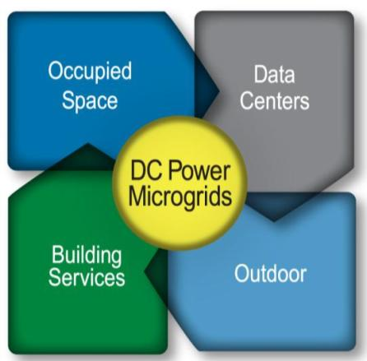
DC Microgrids Can Help In Buildings
Microgrids are for buildings not just ‘Smart’ grids
DC Power Standards
Building Microgrids
Notes:
DC Microgrids Can Help In Buildings:
Let’s visualize the uses of DC power in buildings in the areas where power standards are, or will be, focused on:
From interiors and occupied spaces where lighting and controls are an excellent example of DC electrical loads.
To data center rooms and server racks with their IT equipment
To outdoor electrical uses such as Electric Vehicle charging and outdoor LED lighting
To building services and HVAC and motor equipment, which are increasingly DC as well as a result of using variable speed drives.

Slide 8
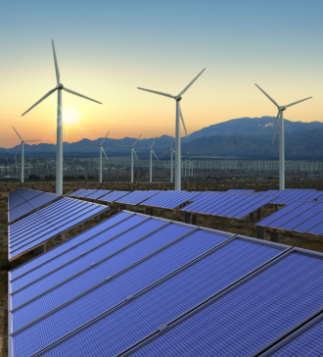
New DC Power Standards Are Helping
Industry standards are key
DC Power Standards
There are new standards for generating and distributing DC power in buildings.
Power Sources
Solar PV
Wind
Battery
Storage
Gen Set
Fuel Cell
Other
Utility Meter
MPPT
Wind
Contr.
380VDC
Converter
Facility Power Server and Common Distribution / Collector (380VDC Nom) Bus
Lighting Loads
24VDC
Plug Loads
380VDC
EV Charger
380VDC
HVAC
Loads
380VDC
Electronic Loads
380/24VDC
ICT
Desktop
24VDC
Data Center
380VDC
Electrical Loads
Notes:
New DC Power Standards Are Helping:
One of the ways buildings are changing…
…Is in the way that they are POWERED.
How many of you have had Renewable Energy sources -- such as Solar or Wind -- considered on one of your projects?
New power distribution methods and configurations beg for new power distribution standards to be created.
The ‘good’ news is…
…they are on the way via the EMerge Alliance

Slide 9
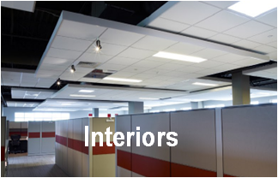
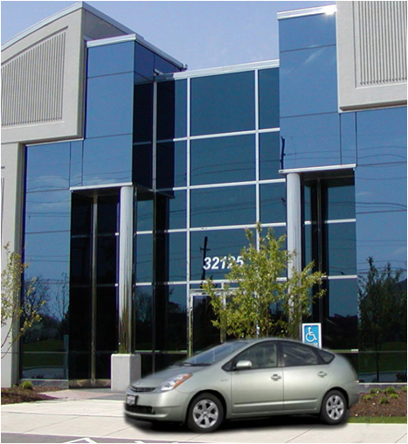
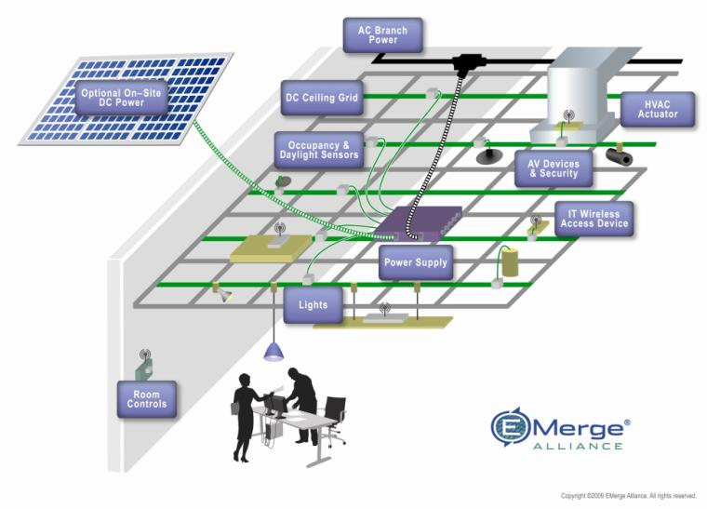
Hybrid AC/DC Buildings Are the 1st Step
A ‘Net Zero’ future starts now
Design Strategies
We can begin to leverage Hybrid Power for Building Interiors Now!
Notes:
Hybrid AC/DC Buildings Are the 1st Step:
Just like we’ve leveraged hybrid power systems for cars…
…these new standards leverage hybrid power distribution topologies for buildings.
The first step for most people will be to convert their occupied interior spaces to more versatile and efficient dc microgrids.

Slide 10





Plug & Play Installation
Reduces time, increases flexibility
Notes:
Plug & Play Installation:
Rather than take the time to detail everything that’s involved…
Here’s a brief animation of what the standard calls for…
While a real installation isn’t quite this fast, it can reduce the renovation or new installation time to less than half the hard wired AC equivalent.
And moving things around to accommodate new layouts or personal preferences is even faster.
It brings a whole new level of flexibility to room and building layouts.

Slide 11

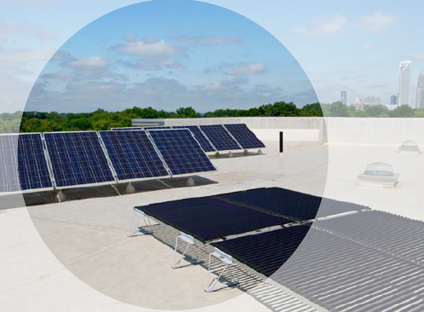
Low Voltage DC Is Key
LVDC technology can help make it happen
Flexibility
Plug & play use of devices, upgradeable
Faster, easier, cheaper for moves, adds & changes
Energy Savings
Less conversions in DC sources & loads
LED lighting: 5-15% more efficient, driven by DC
Sustainability/Reliability
Re-use/Re-configurability of buildings &equipment
Improved Reliability of clean energy & DC devices
Smarter buildings for Smart Grid Integration
Notes:
Low Voltage DC Is Key:
A DC power system based on ceiling grid can deliver improved value to owners. The benefits are both practical and aspirational.
Flexibility:
In a very basic way, building owners and facility managers see value in using the grid as a safe, plug & play electrical infrastructure.
One churn of space can pay for the DC grid because of labor savings from no rewiring.
Energy Savings:
They also expect to see energy savings benefits when DC-based power sources like solar, or DC-based devices like LED lighting ,are used.
You can skip the conversion loss from AC-DC. They get that.
Sustainability/Reliability:
But another part of the appeal is more aspirational -speaking to some owners’ goals to have “green buildings” or to position their company as a leader in sustainability.
And less and simpler power electronics mean inherently improved reliability and reduced maintenance.
Notice that the value proposition is tied to building owners – not to our typical constituents of architects and interior designers.
And the energy savings component has become more important as a key focus of building owners and those driving new building design.

Slide 12
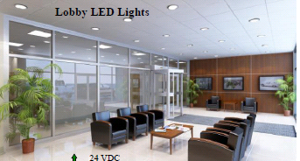
Getting Started Now with Interiors
Start by setting up DC microgrids at the room level
Buildings
3.0
Start Small
  No space is too small to begin your move to Net Zero
  Start with Suspended Ceilings:
      70% of buildings use them
  UL recognized product is readily available
Finish Big
  Scaling flexibility allows you to be “opportunistic” with timing
  Focus on both new construction and Renovations/New Fit-outs
  Site-based generation and storage can be added at any time
EMerge Alliance Corp - ©2009-2010
Notes:
Getting Started Now with Interiors :
Start Small:
So, how do you get started with such a monumental task like changing power systems?
Like a ‘big’ things, you start ‘small’
The inherent nature of a microgrid is that it can be small…
…like think of your laptop power system – it’s a dc microgrid (you might even call it a nanogrid).
Small in a ‘building’ context is a one or more ‘room level’ solution
The good news is that UL recognized and EMerge Alliance registered products are readily available to start at this level.
Finish Big:
And although you don’t have to do everything at once, as opportunity and economics allow, each new revovation will tie-back into the microgrid network you are creating in the building.
Even new construction will be on the same standard...
…and even if you don’t start with site-based generation and storage, it’s accommodated in the standard and can be added at anytime in the life of the building.

Slide 13
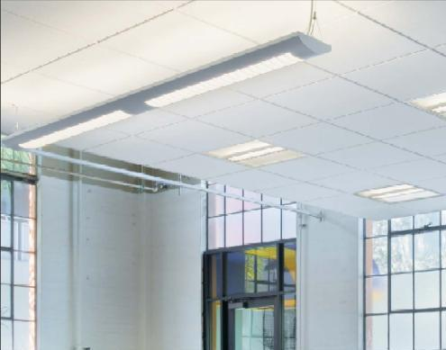
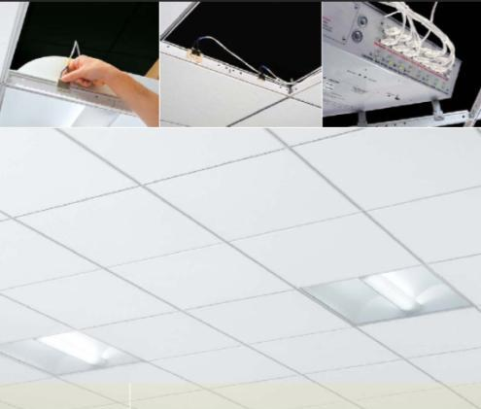
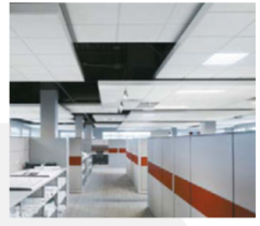
The Occupied Space Solution is Unique
Embedded power is “invisible” in ceilings
Product Information
Is Readily Available
Architectural Design Guides
Electrical Design Guides
Notes:
The Occupied Space Solution is Unique:
Particular care was taken in setting up the Occupied Space standard so as not to negatively impact design freedom and aesthetic beauty of interiors.
The primary implementation ‘embeds the power infrastructure in the ceiling itself…
…making it ‘invisible.’
You might say, from a visual standpoint, it’s remarkably ‘unremarkable!’

Slide 14

The Solution Is Well Supported
The eco-system for DC is rapidly building
Power
Power Servers
MPPTs
Solar Arrays
Wind Turbines
Electric Generation
Electric Storage
Infrastructure
Cabling
Ceiling Grids
Bus Bars
Powered Ceiling Grid
Plug Strips
Connectors
Peripherals
Light Fixtures
A/V Equipment
Security Cameras
Window Shades
VAV Actuators
Wireless Repeaters
Controls
Motion Sensors
Occ. Sensors
Photo Sensors
Dimmers
Lighting Controls
Room Controls
Thermostats
A
Systems
Portfolio
Basic System Components
Notes:
The Solution Is Well Supported:
From power sources to peripheral devices and the infrastructure and control to connect and operate them, the eco-system for occupied space dc microgrids is in place and rapidly growing.
Categorically, each class of equipment is evaluated and registered to operate with repect to the EMerge standard.
The EMerge website is regularly updated with the latest products for specifiers to refer to.

Slide 15
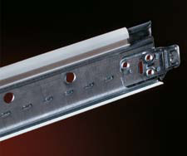
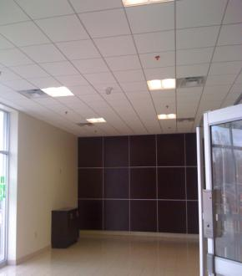
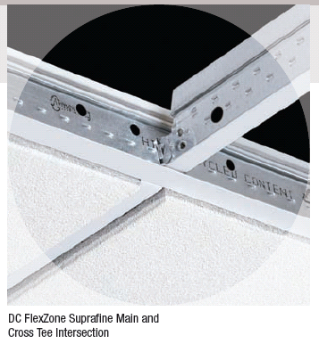
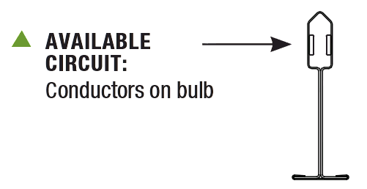
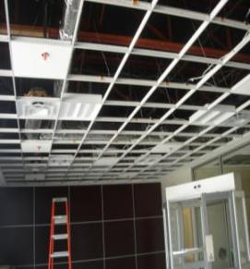
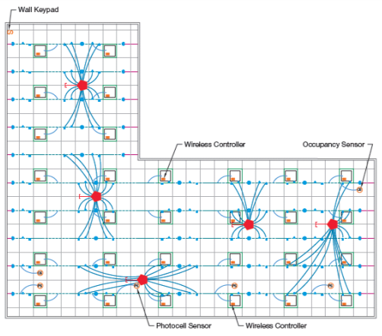
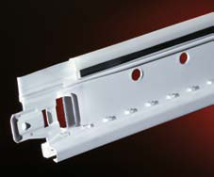
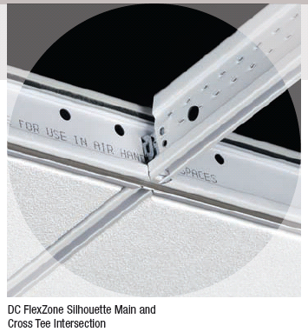
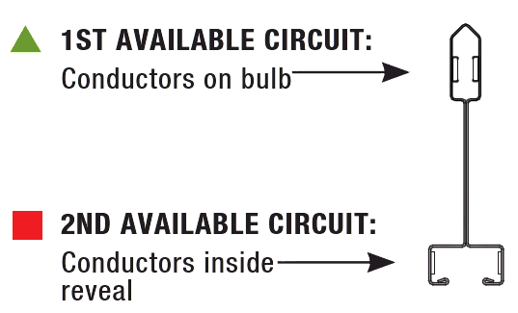
The Ceilings’ Role
A suspended ceiling makes it easy
Ceiling Grid Products
Notes:
The Ceilings’ Role:
As a basic part of the ‘wiring’ infrastructure, a suspended ceiling makes an ideal platform for embedded power distribution.
One or two busses can be ‘built-in’ to the otherwise basic ceiling grid.
The busses accommodate both connections from the server as well as connections to the device peripherals…
…as well as providing mechanical support for the power server and all of the ceiling mounted device peripherals.
Both mechanical and electric elements of the layout are included as ‘drawing layers’ in the reflected ceiling plan.

Slide 16
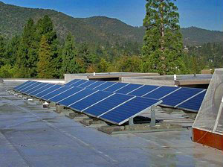
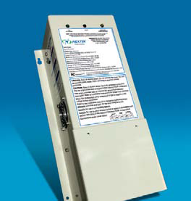
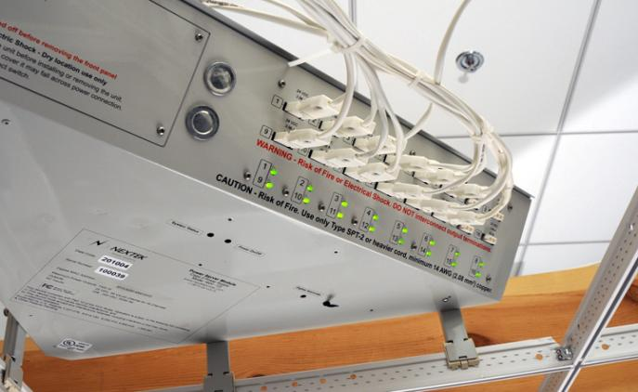
The Power Systems’ Role
Class 2 LVDC at the ‘fringe’
Power Controllers
Power Server Modules
Power Sources
Power channels form ‘power-pixels’ instead of branches
Notes:
The Power Systems’ Role:
The power delivery systems typically includes …
power sources … which are utility or site based;
power controllers… like maximum power point trackers, voltage protection, and centralized rectifiers, and…
power servers modules … that determine final constant voltage and current limits.

Slide 17
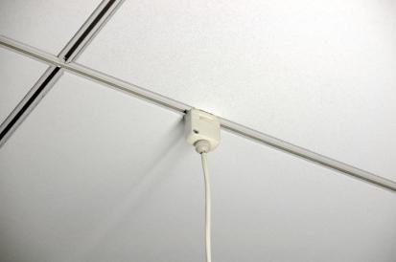

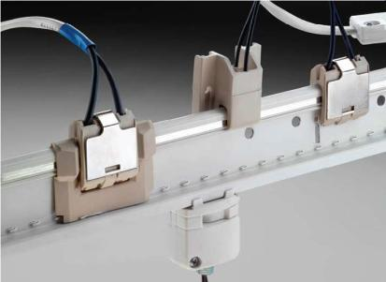
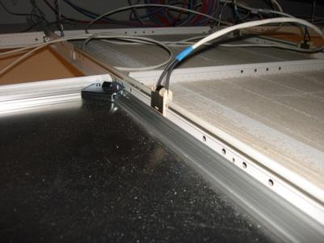
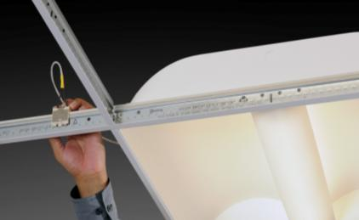
Cabling and Connectors’ Roles
The ‘Plug’ part of ‘plug-n-play’
Bus Bar Connections
Integral Bus Bar Connectors
Power Server Connectors
Load Device
Cable Assemblies
Power Feed
Cable Assemblies
Power Interconnection Products
Notes:
Cabling and Connectors’ Roles:
Cabling systems typically include …
power feed cable assemblies… which connect the power servers to the bus bars and/or dedicated device wiring;
load device /peripheral cable assemblies… which connect the ceiling embedded bus bars to the room loads.
Standardized connectors include …
Bus bar connectors … for both source and load connection above the ceiling
Power server connectors… of power supply connections
Integral bus bar connectors… for load connection below the ceiling

Slide 18
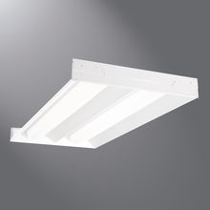
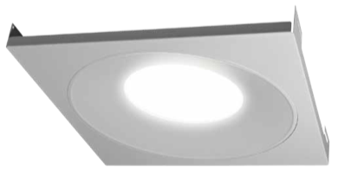
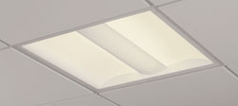
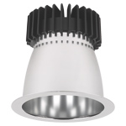
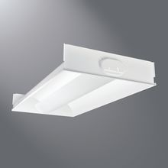
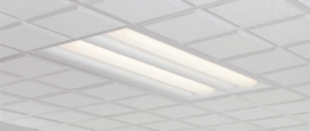
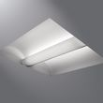


Lighting’s Role
Lighting includes both LED and fluorescent
Notes:
Lighting’s Role:
Well, you know lighting… but it does include both fluorescent and LEDs

Slide 19
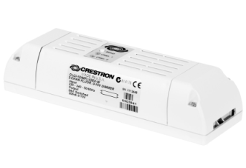
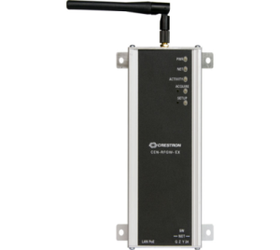

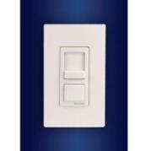
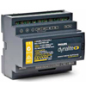
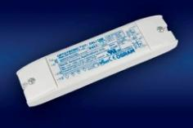
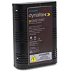




Control’s Role
The controls are typically the same
Ballasts, Drivers, PWMs
User Interfaces
Sensors & Detectors
Gateways & Controllers
Notes:
Control’s Role:
The same here.
No surprises…
…except if you need 24 VDC to run the electronics, forget the special power supply or transformer and just tap-in at the most convenient location or directly to the power server.

Slide 20
Basic Control Communications
Favors an ‘open’ protocol fringe
System Layer
Local Controls & Gateways
Fringe
Control
Supervisory
Embedded Control/Sensor
Building Automation
Equipment
Local Controllers
Proprietary
Hybrid
Open
Exclusivity
System
ZigBee™ - Wireless
PLC – Wired
Other Proprietary
Local
BACnet®
LonWorks®
ModBus
Other Proprietary
Device
Protocol
Notes:
Basic Control Communications:
Let’s take a closer look at the basic controls communication scheme:
We divide the controls domain into three basic domains…
The Supervisory layer…
…where typically, Building Automation Systems and Proprietary communications prevail;
The Control layer…
…where either Hybrid proprietary/open protocols can be used …
…with local Controllers & Gateways give access to the supervisory system , and;
The Fringe layer…
…where the vast number of devices reside…
…with Embedded Control & Sensing capability
…and where and a wired or wireless Open protocol is ideal
…the later being preferred.

Slide 21









How It All Fits Together
Pre-determined integration
Power
Infrastructure
Peripherals
Controls
Notes:
How It All Fits Together:
The integration is highly pre-engineered…
Power Infrastructure, Peripherals and controls, all on one convenient design platform.

Slide 22


Example: Project Documentation
Reflected ceiling plan details
Notes:
Example: Project Documentation:
And even the documentation is simplified…

Slide 23

Occupied Interior Space Examples
The applications are not restricted
Design Strategies
DC Powered Interior Spaces:
Notes:
Occupied Interior Space Examples:
Here are some examples of early implementation of this low voltage DC power approach provided by the EMerge Alliance
Notice these include pilots by the US Green Building Council itself in their own space
as well as architects, engineers, and utility companies looking to model new ways of design for their clients

Slide 24


Energy Efficient Design
Ohm’s Law makes a difference
Technical
Strategies
  Energy Conversions Effect Energy Efficiency
<DC>
vs.
<AC>
Efficiency is >10-15% higher with solar, wind & on-site storage.
Notes:
]

Slide 25

Example: DC Power in the classroom
AC & solar sources connected to safe DC Loads.
Allows maximized return on investments in alternative energy
Lights and controls are powered from the ceiling grid,
and can be moved safely & easily with no rewiring!
Notes:
Example: DC Power in the classroom:
LEED is also starting to recognize importance of incorporating flexibility into interior design
New2012 credit areas include one specific credit focused on Flexible Design
Although currently envisioned with Healthcare in mind…
comments are being made about the importance of design flexibility in many types of buildings

Slide 26


Enabling adaptive classrooms
Changes are fast and easy
Based on actual classroom use and configuration, change the lighting without rewiring
  Remove all 15 lights & re-install in new locations in 2 rooms
Time to convert:
  1 person
  1 hour
  No rewiring
  Plug and play
New configuration
Fewer lights
Notes:
Enabling adaptive classrooms:
In this particular case, the owner was looking for a system that would allow classrooms to be reconfigured every semester, based on enrollments, instruction method and subject matter:
Fast reconfiguration of lighting and A/V equipment were considered the keys.
You can see the results demonstrated that the owner’s desire was feasible.
This design is in the process of being specified in a major post secondary education facility.

Slide 27





Case Study: EMerge Standard at PNC
Producing more than it consumes
DC PHOTOVOLTAICS
DIFFUSED DAYLIGHTING
DC PHOTOVOLTAICS
ENERGY RECOVERY UNIT
DC FLEXZONE CEILING, LED
LIGHTING & OCCUPANCY SENSORS
VEGETATIVE WALL
NATIVE PLANTS,
IRRIGATION &
GROUNDWATER
INFILTRATION
PNC Financial Services Group Inc. announced it will debut its new net-zero energy bank branch during first quarter 2013 in Fort Lauderdale, Fla.
PNC expects the branch to exceed LEED Platinum certification and be its most energy efficient, using 50 percent less energy than a typical branch.
The bank features solar connected DC ceilings that distribute native dc electricity to power efficient solid-state LED lighting and controls.
Notes:
Case Study: EMerge Standard at PNC:
The Alliance’s Occupied Interior Space Standard was beta tested in actual PNC building environments for almost two years during design development.
Beta sites in a variety of building types were utilized to validate various aspects of the Interior Occupied Space standard during its development by the Alliance members.
Some of the sites included integration of photo voltaic generation as part of the system.

Slide 28


Case Study: UC San Diego SRC
Alternative energy doubles relative efficiency gain
Design Strategies
Sustainability Resource Center (SRC)
Office space, reception, and library
Student, campus and community use
Sustainable materials, efficient lighting & controls
On-site solar array
Uses Solar Generated DC Directly
Notes:
Case Study: UC San Diego SRC:
Here’s more detail on how one project designed DC power distribution directly into their project:
The new Sustainability Resource Center at the University of California – San Diego was looking for innovation in green building strategies
As a leader in promoting new energy approaches and a regular user of solar power already on campus
they decided to implement direct DC distribution through a new array just for this project

Slide 29


Energy Use Analysis
Enhanced certification opportunities
Design Strategies
  Improved power and lighting efficiency
  Because of fewer power conversions at solar & fixture level
  Won 2010 Best Practice Award for Lighting Design & Retrofit, California Higher Education Sustainability Conference
  Achieved LEED-CI Gold
  Innovation Credit:
    “High Efficiency DC Microgrid”
Notes:
Energy Use Analysis:
This use of direct dc power led the SRC to better power and lighting efficiency
In fact, they won several awards
And a LEED-CI Gold rating for the project
Which included an Innovation Credit for the “High Efficiency DC Microgrid”

Slide 30


Flexible by Design
Flexibility is enhanced not compromised
Design Strategies
  New Credit Area for LEED 2012
  Designing Spaces to Give Owners Ability to Modify without Significant Reconfiguration or Rewiring
  Expands on Current Credit Areas focused on:
    Buying or Generating Renewable Energy
    Implementing Energy Efficient Systems… Lighting, Sensors, HVAC, Building Controls
Notes:
Flexible by Design:
LEED is also starting to recognize importance of incorporating flexibility into interior design:
New 2012 credit areas include one specific credit focused on Flexible Design
Although currently envisioned with Healthcare in mind…
…comments are being made about the importance of design flexibility in many types of buildings

Slide 31

Are Data Centers Next?
Focused on energy efficiency & surety
Future
Opportunities
Huge energy user in buildings
Not just Google or Facebook
99% are “small” (server rooms, closets, etc…2.5 million total)
  Contain majority of all servers (57%)
  From 2-32 servers per location
  Less internal expertise in power/space/heat management
6 billion KW hours could be saved each year with a 10% improvement in data center energy efficiency
Sources: EPRI, EPA
Notes:
Are Data Centers Next?
Data Centers are huge energy users in buildings:
There are data centers in nearly every building and project – it’s not just the huge server farms for clients like Facebook and Google!
In fact, 99% of all data centers are consider “small”
But they contain the majority of all servers using power
The challenge comes in that these smaller data centers don’t often have the internal expertise to focus on new methods of power distribution and use
The EPA has estimated that 6 billion kilowatt-hours of energy could be saved EACH YEAR with just a 10% improvement in data center energy use

Slide 32


The Standards Are Being Implemented
EMerge standard has been issued
Technical Strategies
New Standard
Notes:
The Standards Are Being Implemented:
Again, there are some new application standards for DC power use in Data and Telecom Centers
The EMerge Alliance has a technical group led by the Electric Power Research Institute and including Intel and other key players in the data center industry…
…that released a new standard
Whose key elements are pictured here

Slide 33

DC Data Center Demo Sites
The technology has been validated
Design Strategies
Notes:
DC Data Center Demo Sites
Standards have been created and released and implementation in data centers has started:
Several leading groups validated approaches for DC in data centers
This includes Lawrence Berkeley National Labs, Duke Energy,
and again, the University of California – San Diego, a national pioneer in new energy research and innovation

Slide 34


Green.ch-ABB Zurich-West
380Vdc Data Center
EMerge Alliance Data/Telecom Standard
Full scale applications in the field
ABB/Validus Power Distribution
  In: 16KV AC
  Out: 1MW @ 380Vdc
  Battery Backup: 10 mins
  Backup Generation
1,100m² of 3,300m² Vdc
HP 2U, Blades & Storage Servers
Demonstrated Benefits
  10% Better Energy Efficiency
  15% Lower Capital Cost
  25% Smaller Footprint
  20% Lower Installation Costs
16KVac
3Ø
Rectifier
380Vdc
Datacenter Servers
Battery Storage
Photos courtesy of ABB* and HP*
Notes:
EMerge Alliance Data/Telecom Standard :
DC power delivery could potentially enhance energy efficiency in data centers
it is a pressing need for densely packed racks of servers that use dc power.
Currently in such centers, ac is converted to dc at the uninterruptible power supply (to facilitate storage), then is converted again to push out to the servers, and is converted one more time to dc at each individual server.
These conversions waste power and generate considerable heat, which must be removed by air conditioning systems, resulting in high electricity costs.
The benefits include :
Better energy efficiency
Lower Capital Cost
A smaller equipment footprint
Lower Installation Cost
Lower total cost of ownership

Slide 35

Q & A
Notes:
Q & A:
This concludes the session.
Questions?
Thank you for your interest and participation.

